Slide 1

WEEK 8
PHP and MySQL Level 4 Introduction to Internet Software Architecture

Slide 2
Week 8 Lecture Topic
HTTP methods (GET, POST, PUT, DELETE)
Fetch functions
JSON in PHP
mysqli

Slide 3
HTTP METHOD
HTTP methods are used in PHP to interact with servers
and perform actions like retrieving, sending, updating, or deleting data.
The common HTTP methods are:
GET
POST
PUT
DELETE, e.t.c.

Slide 4
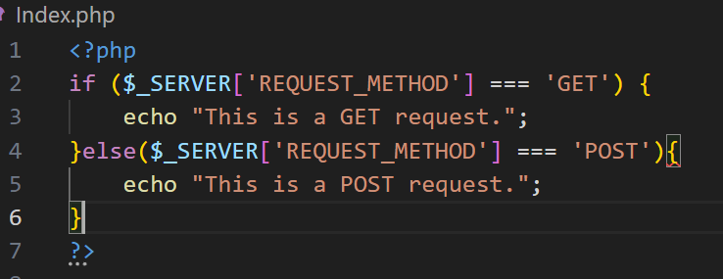
Detecting the HTTP Method
You can use the $_SERVER['REQUEST_METHOD'] variable to determine the HTTP method used in the request.

Slide 5
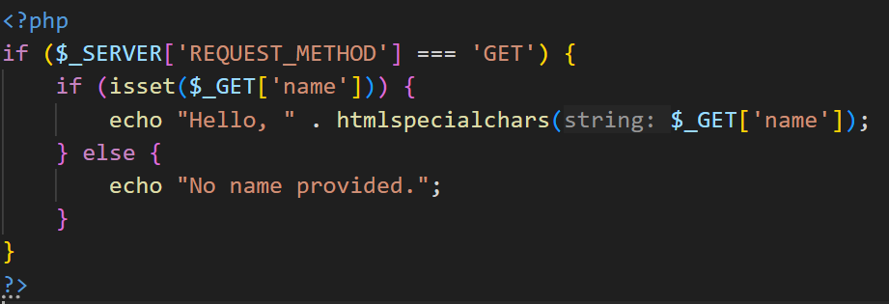
Handling GET Requests
GET is used to retrieve data from a server.
Parameters are sent via the URL query string and can be accessed using $_GET.

Slide 6
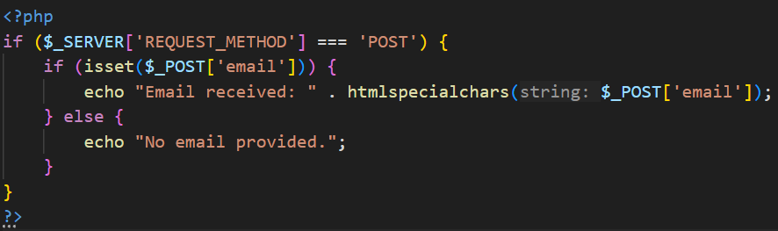
Handling POST Requests
POST is used to send data to the server, usually for creating or updating resources.
The data is sent in the request body and can be accessed using $_POST.

Slide 7
Handling PUT Requests
Used for updating data.
Can also create a resource if the server allows it.
Data is sent in the request body, typically in JSON or URL-encoded format.

Slide 8
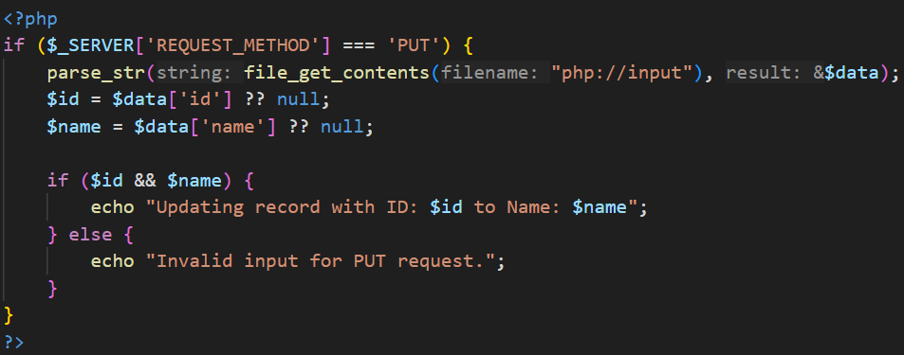

Slide 9
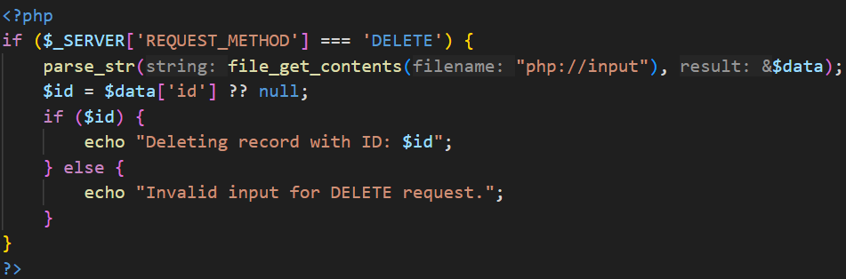
Handling DELETE Requests
Used for deleting data.
Often includes the identifier of the resource to delete in the URL or request body.

Slide 10
Fetch Methods
mysqli_fetch_assoc()
Fetches a single row as an associative array.
Keys are the column names from the database

Slide 11
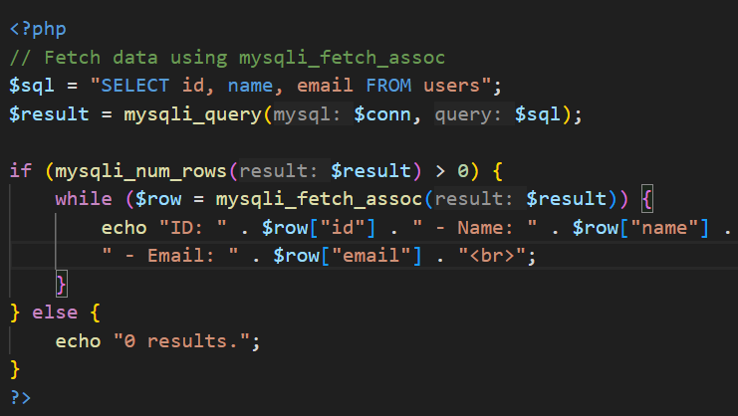
Fetch Methods

Slide 12
Fetch Methods
mysqli_fetch_row()
Fetches a single row as a numerically indexed array.
Useful when column names are not needed.
mysqli_fetch_array()
Fetches a single row as both associative and numeric arrays.
Consumes more memory compared to other methods.
mysqli_fetch_object()
Fetches a single row as an object.
Allows accessing fields using -> notation.

Slide 13
JSON Handling in PHP
What is JSON?
A lightweight data-interchange format.
Easy for humans to read and write.
Easy for machines to parse and generate.
Key Functions:
json_encode(): Converts PHP arrays or objects into JSON strings.
json_decode(): Converts JSON strings into PHP arrays or objects.

Slide 14
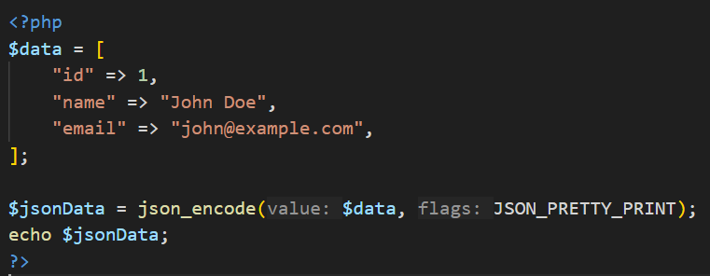
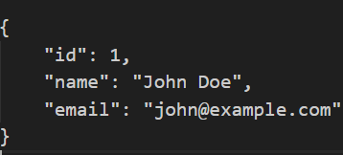
JSON Handling in PHP
Output :

Slide 15
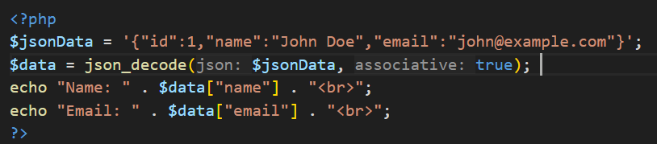
Decode JSON to PHP Array

Slide 16
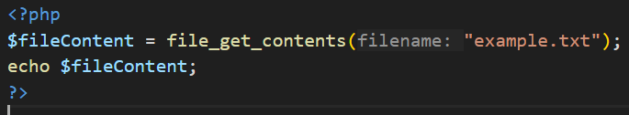
file_get_contents
The file_get_contents() function in PHP is used to read the contents of a file into a string.

Slide 17
MySQL PHP Drivers
What is mysqli?
Definition: mysqli (MySQL Improved) is a PHP extension for interacting with MySQL databases. It offers:
Object-oriented and procedural approaches.
Better performance and security than the older mysql extension.
Key Features:
Supports prepared statements.
Supports multiple statements.
Enhanced debugging capabilities.

Slide 18
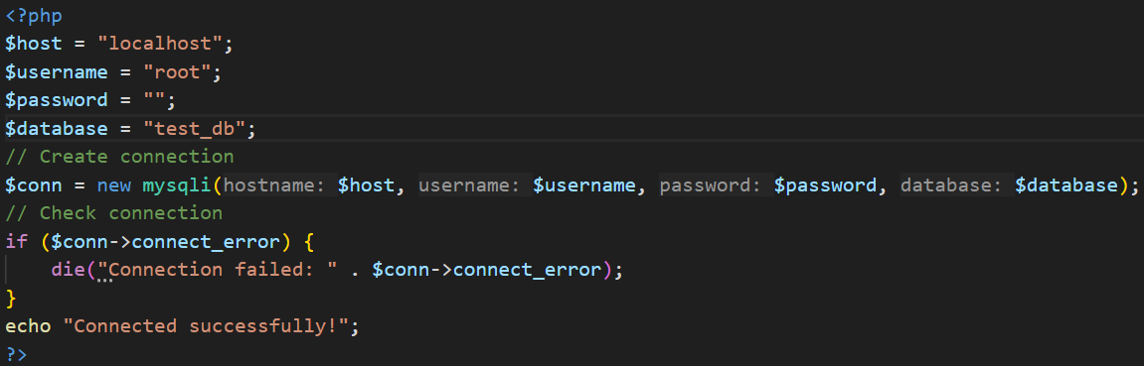
Connecting to a Database
Using both object-oriented and procedural methods.
Handling connection errors gracefully.
Object-Oriented Approach :

Slide 19
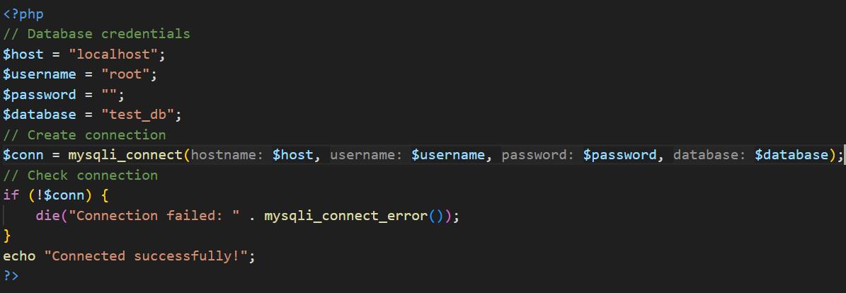
Procedural Approach

Slide 20
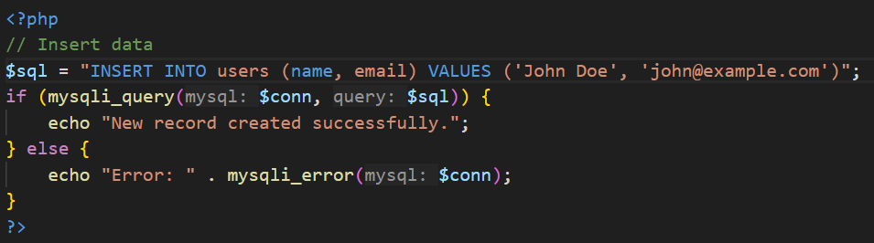
Basic Queries
INSERT Data :

Slide 21
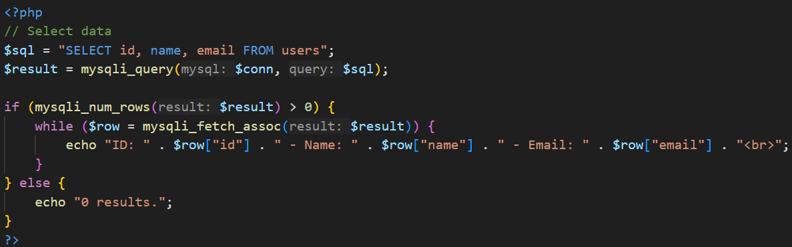
SELECT Data:

Slide 22
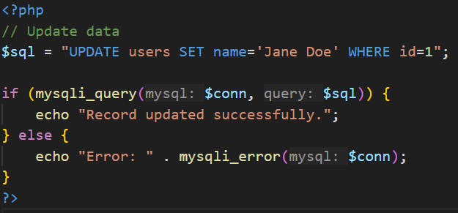
UPDATE Data:

Slide 23
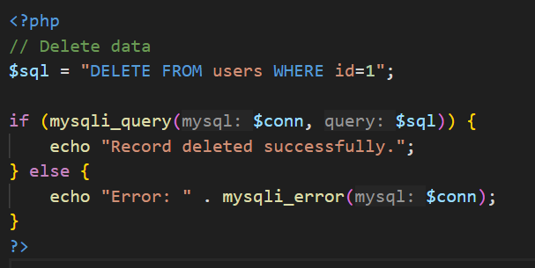
DELETE Data:

Slide 24

Any Questions

Slide 25


